Slide 1
Lecture-9 Generations of Cellular System

Slide 2
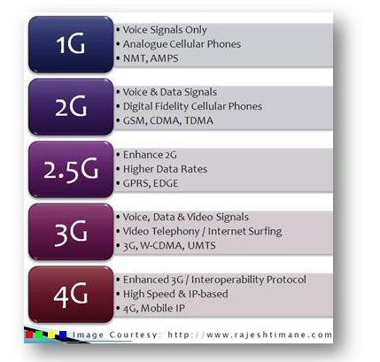
1G, 2G, 3G, 4G --The Evolution of Wireless Generations

Slide 3
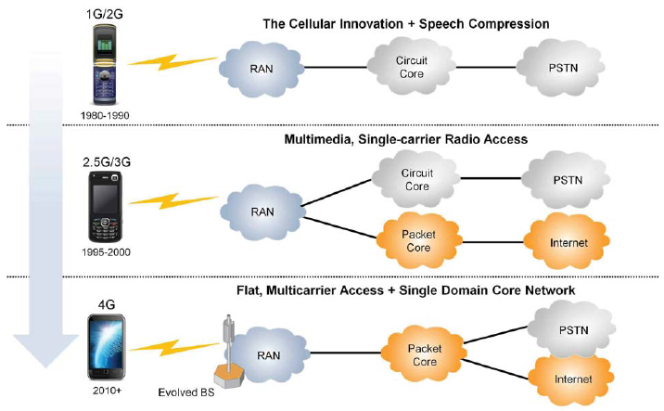
Evolution in Network Structure
1G/2G: Circuit switching only
2.5G/3G: Both circuit switching and packet switching
4G: Circuit switching eliminated; packet switch only (All-IP)
Source: LTE Network Evolution and Technology Overview, White Paper by Tektronix Communications, USA

Slide 4
1st Generation—Analog System
The 1G mobile cellular systems were analog speech communication systems.
Use of multiple cell sites,
7-reuse factor
Automated Handover
The first commercially automated cellular network (the 1G generations) was launched in Japan by NTT in 1979.
In the United States, the Advanced Mobile Phone System (AMPS) was launched in 1982.

Slide 5
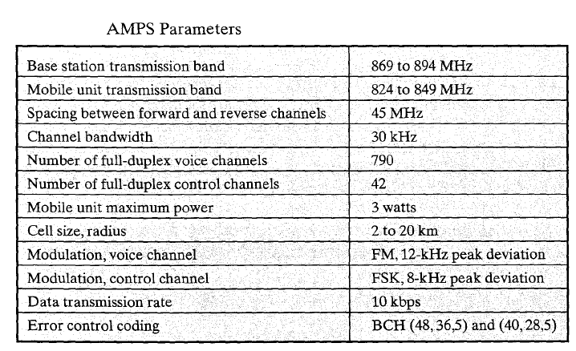
Notes:
the Bose–Chaudhuri–Hocquenghem codes (BCH codes) form a class of cyclic error-correcting codes

Slide 6
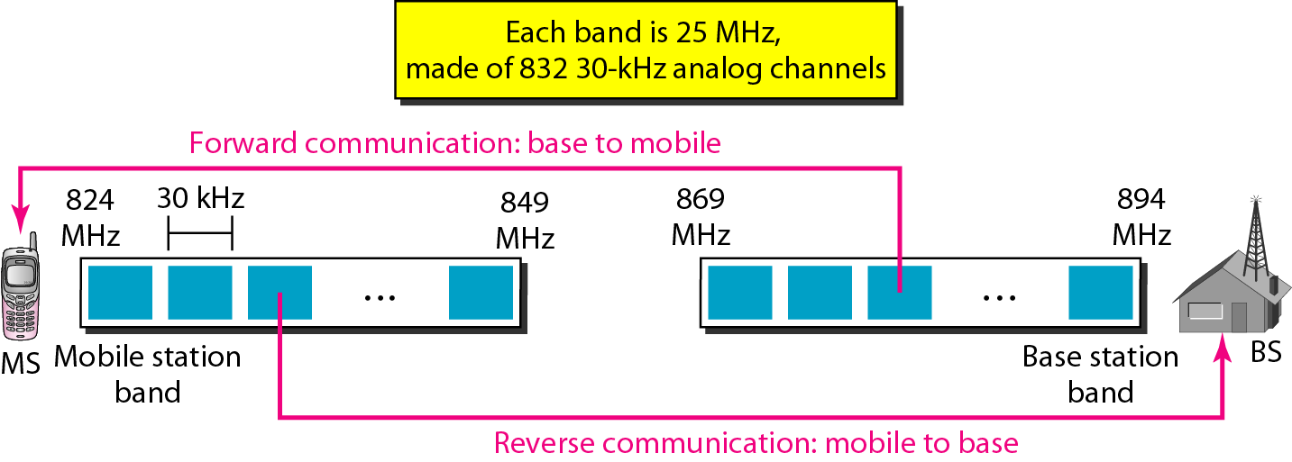
Cellular bands for AMPS
Notes:
The band between 824 and 849 MHz carries reverse communication; the band between 869 and 894 MHz carries forward communication.

Slide 7
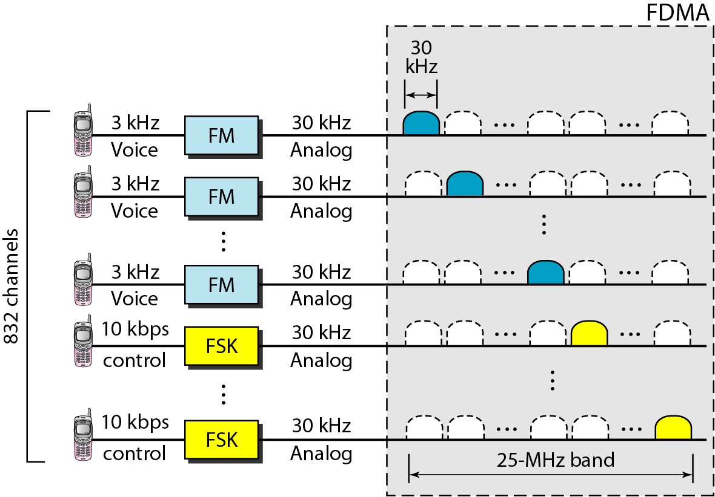
AMPS reverse communication band
Notes:
Transmission AMPS uses FM and FSK for modulation. Figure shows the transmission in the reverse direction. Voice channels are modulated using FM, and control
channels use FSK to create 30-kHz analog signals. AMPS uses FDMA to divide each 25-MHz band into 30-kHz channels.
NB: We know human voice frequency BW 3 kHz. That’s why it is 3kHz. And control signal deals with data, that’s why it is 10kbps.

Slide 8
1G: Challenges and Issues
While the 1G systems aroused the market popularity internationally they were restricted by
The small coverage areas
Poor speech quality and
Poor battery performance
Poor systems capacity
These shortcomings were overcome by introducing digital communication systems, resulting in the 2G systems

Slide 9
2nd Generation—Digital System
Introduced in the late 1980s, are based on digital transmission.
Motivation for 2G is Digital Cellular:
Increase System Capacity
Add additional services/features (SMS, caller ID, etc..)
Reduce Cost
Improve Security—Error detection, encryption
Interoperability among components/systems (GSM only)
Dynamic Channel Allocation

Slide 10
Differences Between First and Second Generation Systems
Digital traffic channels – first-generation systems are almost purely analog; second-generation systems are digital
Encryption – all second generation systems provide encryption to prevent eavesdropping
Error detection and correction – second-generation digital traffic allows for detection and correction, giving clear voice reception
Channel access – second-generation systems allow channels to be dynamically shared by a number of users

Slide 11
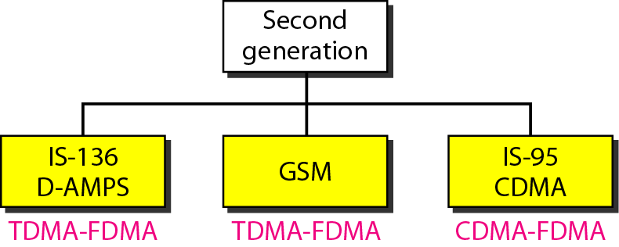
2nd Generation Cellular Systems
Notes:
IS-136 (Interim Standard 136)

Slide 12
2G: GSM
The Global System for Mobile Communication (GSM) is a digital cellular phone system using TDMA and FDMA.
Reduced RF transmission power and longer battery life.
International roaming capability by using SIM
Better security against fraud (through terminal validation and user authentication).
Encryption capability for information security and privacy.
Short Message Service (SMS)
up to 160 character alphanumeric data transmission to/from the mobile terminal
Provide data services for wireless users.

Slide 13
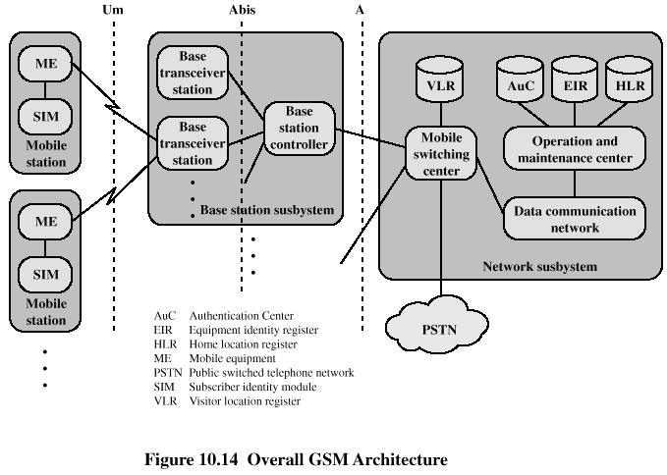
GSM Network Architecture
Notes:
Um interface The "air" or radio interface standard that is used for exchanges between a mobile (ME) and a base station (BTS / BSC).
Abis interface This is a BSS internal interface linking the BSC and a BTS,
A interface The A interface is used to provide communication between the BSS and the MSC.

Slide 14
Mobile Station
Mobile station communicates across Um interface (air interface) with base station transceiver in same cell in which the mobile unit is located.
Mobile equipment (ME) – physical terminal, such as a telephone or PCS
ME includes radio transceiver, digital signal processors and subscriber identity module (SIM)
GSM subscriber units are generic until SIM is inserted
SIMs roam, not necessarily the subscriber devices
The Um interface contains all the mechanisms necessary for wireless transmission (TDMA, FDMA etc.).
Notes:
The mobile equipment (ME) refers to the physical terminal, such as a telephone or PCS (personal communications service) device, which includes the radio transceiver, digital signal processors, and the subscriber identity module (SIM).

Slide 15
GSM SIM
Subscriber Identity Module
Smart card or plug-in module to activate unit
Stores
subscriber’s identification number
networks subscriber is authorized to use
encryption keys
Can use any unit anywhere with your SIM

Slide 16
Base Station Subsystem (BSS)
BSS consists of base station controller and one or more base transceiver stations (BTS)
Each BTS defines a single cell
includes radio antenna, radio transceiver and a link to a base station controller (BSC)
BSC may control multiple BTS units and hence multiple cells.
reserves radio frequencies, manages handoff of mobile unit from one cell to another within BSS, and controls paging.
The Abis interface consists of 16 or 64 kbit/s connections.
Notes:
The BSC sends a paging message to certain BTSs depending on the called mobile unit number. Each BTS transmits the paging signal on its own assigned setup channel.

Slide 17
Network Subsystem (NS)
NS provides link between cellular network and public switched telecommunications networks
Controls handoffs between cells in different BSSs
Authenticates users and validates accounts
Enables worldwide roaming of mobile users
Central element of NS is the mobile switching center (MSC).
Heart of the network which manages communication between GSM and other networks
It is supported by four databases that it controls.

Slide 18
MSC Databases
Home location register (HLR) database: stores information about each subscriber and update the information in HLR as soon as the subscriber leaves its current local area.
Visitor location register (VLR) database: maintains information about subscribers that are currently physically in the region covered by the switching center.
Authentication center database (AuC): used for authentication activities, holds encryption keys.
Equipment identity register database (EIR): Stores all devices identifications registered for this network. Ex-IMEI
Notes:
HLR:- Store data for the home customers or subscribers. Like if you buy SIM from Delhi reason then Your data will store in Delhi HLR and it is permanent store. Its Called Home Locator Register.
VLR:- It store data of visitor location customers or subscribers. If you have Delhi SIM card and you go to Tamilnadu then in Tamilnadu VLR will work for you tamilnadu VLR will store your data on temporary basis for calls. But still your data is remain in Delhi HLR because HLR data is permanent and VLR data is temporary. Its called Visitor Locator Register.

Slide 19
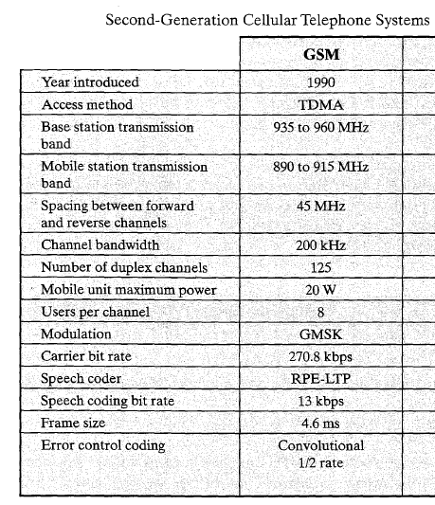

Slide 20
GSM-900 Frequency Band:
Two frequency bands, of 25 MHz each one, have been allocated for the GSM system.
The band 890-915 MHz has been allocated for the uplink direction (transmitting from the mobile station to the base station).
The band 935-960 MHz has been allocated for the downlink direction (transmitting from the base station to the mobile station).
Channel spacing 200 kHz provide 124 channels per cell.
Each channel can support 8 users through TDMA (maximum 992 users per cell, in practice about 500).
Notes:
According to NFAP, spectrum of 900 MHz & 1800 MHz bands are allocated for second generation mobile service. At present five operators are providing this second generation mobile service by GSM technology.

Slide 21
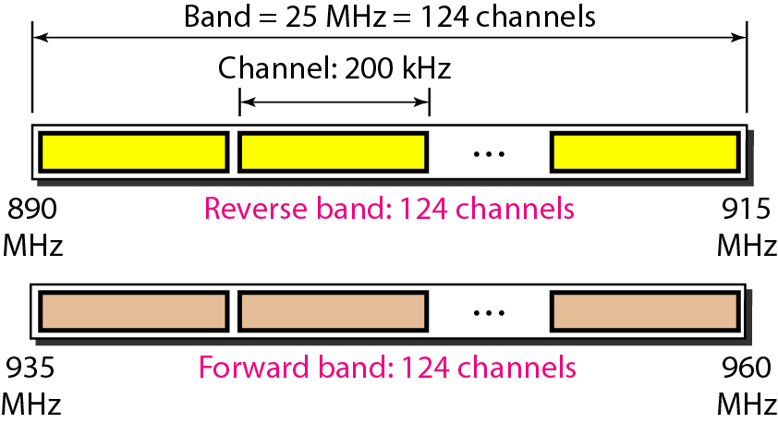
GSM-900 bands
Notes:
Band = 25 MHz
Channel BW = 200 KHz
Total channel = 25 MHz/200 KHz = 125 channels = 124 channel + 1 guard band
1 guard band = 200 KHz

Slide 22
GSM Transmission:
In a GSM System, each voice channel is digitized and compressed to a 13-kbps digital signal.
Each slot carries 156.25 bits. Eight slots share a frame (TDMA).
Twenty-six frames also share a multiframe (TDMA) and each channel takes one multiframe.
Each 270.8-kbps digital channel modulates a carrier using GMSK (a form of FSK used mainly in European systems); the result is a 200-kHz analog signal.
Finally 124 analog channels of 200 kHz are combined using FDMA. The result is a 25-MHz band.
Notes:
Normally a 25 Mhz frequency band can provide 125 carrier frequencies but the first carrier frequency is used as a guard band between GSM and other services working on lower frequencies.

Slide 23
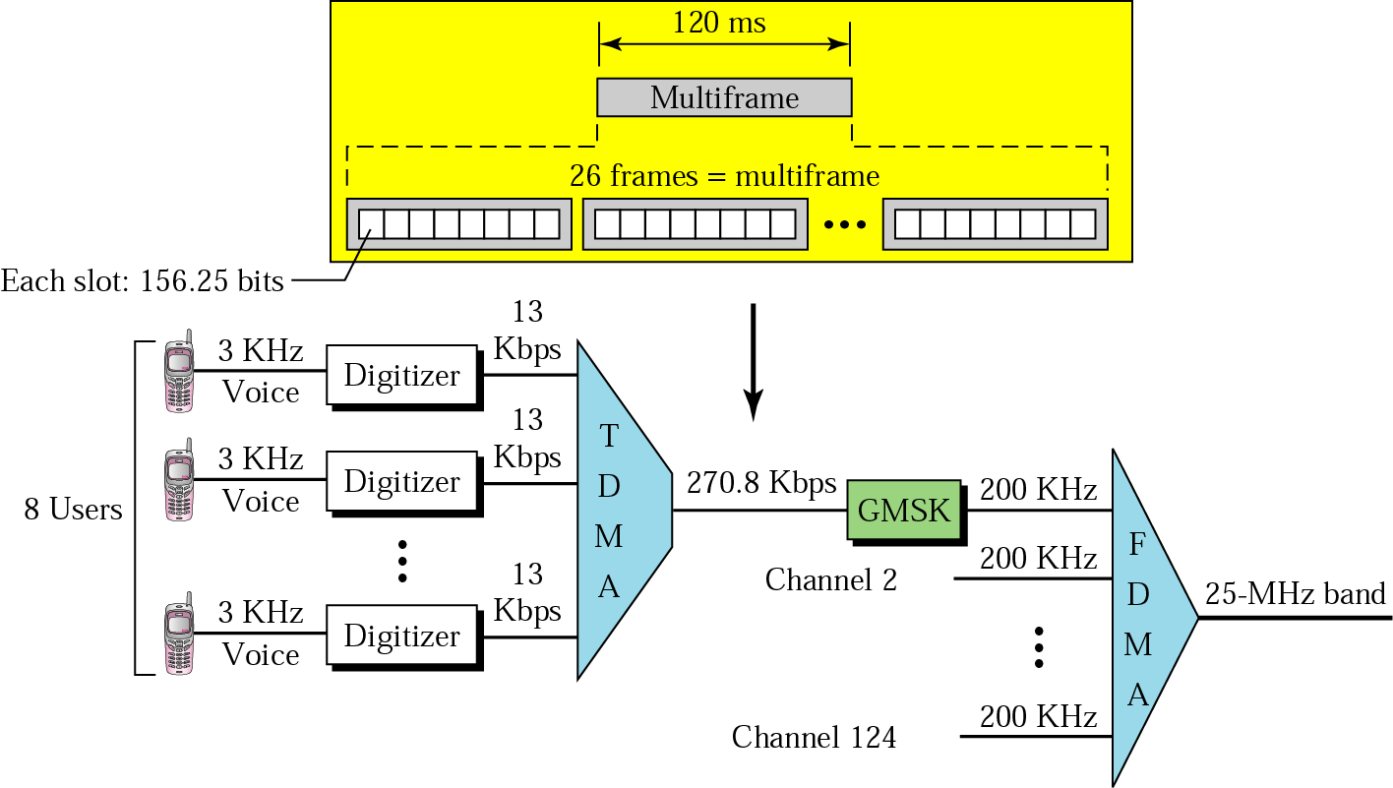
GSM Transmission:
Notes:
GMSK: Gaussian Minimum Shift Keying
Each voice channel is digitized and compressed to a 13-kbps digital signal. Each slot carries 156.25 bits. Eight slots share a frame (TDMA). Twenty-six frames also share a multiframe (TDMA). Each channel takes one multiframe. We can calculate the bit rate of each channel as follows:
Channel Data Rate = 1/120ms x 26 x 8 x 156.25 bits = 270.8 kbps

Slide 24
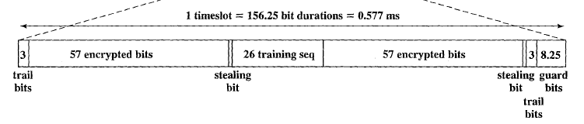
GSM Frame Structure
Trail bits: Allow synchronization of transmissions from mobile units located at different distances from the base station.
Encrypted bits: data is encrypted in blocks, Two 57-bit fields
Stealing bit: this flag indicates the type of data in the data field.
Training sequence: a known sequence that differs for different adjacent cells. It indicates the received signal is from the correct transmitter and not a strong interfering transmitter. It is also used for multipath equalisation. 26 bits.
Guard bits: avoid overlapping, 8.25 bits

Slide 25
GSM Example-1
GSM uses a frame structure where each frame consists of eight time slots, and each time slot contains 156.25 bits and data is transmitted over a channel at 270.833 kbps. Find (i) time duration of a bit, (ii) time duration of a time slot, (iii) time duration of a TDMA frame, and (iv) how long must a user wait when occupying a single time slot between two successive transmissions.

Slide 26
Solution
(i) To find time duration of a bit, Tb
Channel data rate = 270.833 kbps (given)
Time duration of a bit, Tb = 1/data rate
Hence, time duration of a bit, Tb = 1/270.833 kbps = 3.69 us
(ii) To find time duration of a time slot, Tslot
Number of bits per time slot = 156.25 bits (given)
Time duration of a time slot, Tslot = 156.25 bits ⋅ Tb
Time duration of a time slot, Tslot = 156.25 bits ⋅ 3.69 us = 577 us
(iii) To find time duration of a TDMA frame, Tf
Number of time slots per TDMA frame = 8 (given)
Time duration of a frame, Tf = number of time slots ⋅ Tslot
Time duration of a frame, Tf = 8 ⋅ 577 us = 4.616 ms
(iv) To find time duration for a user occupying a single time slot between two successive transmissions has to wait for the time duration of a frame. Hence, a user has to wait for 4.616 ms between two successive transmissions.

Slide 27
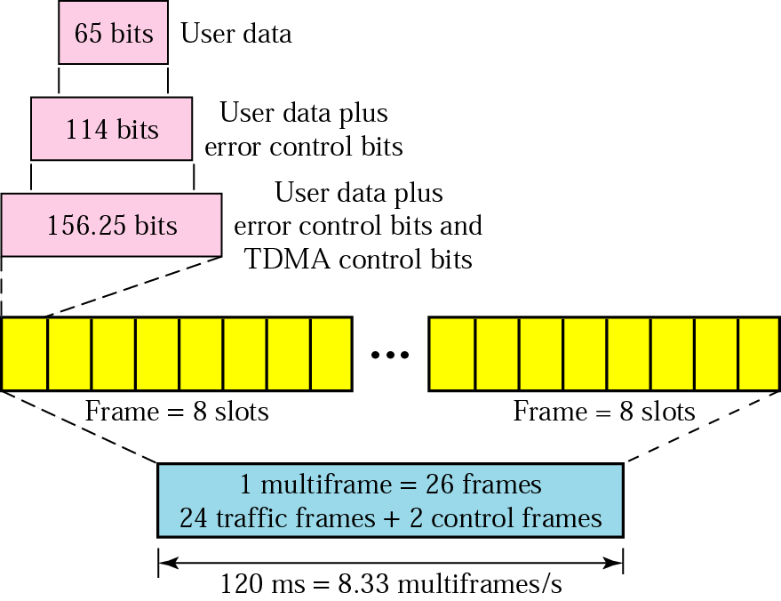
Multiframe Components:
Notes:
The user data are only 65 bits per slot. The system adds extra bits for error correction to make it 114 bits per slot. To this, control bits are added to bring it up to 156.25 bits per slot. Eight slots are encapsulated in a frame. Twenty-four traffic frames and two additional control frames make a multiframe. A multiframe has a duration of 120 ms.

Slide 28
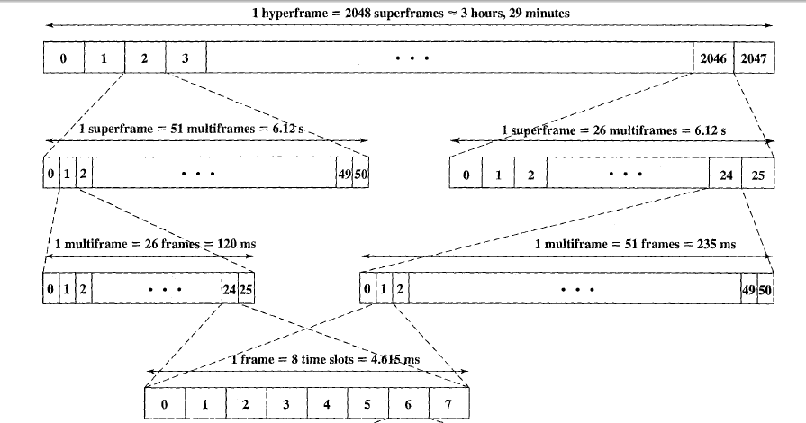
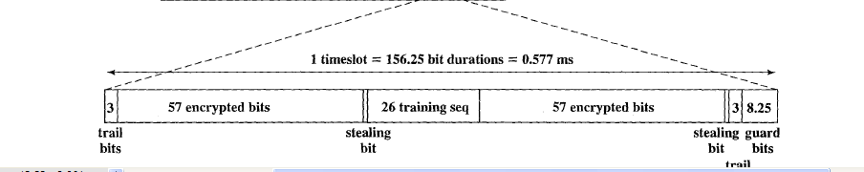
GSM frame format
Notes:
The GSM frame structure is designated as hyperframe, superframe, multiframe and frame. The minimum unit being frame (or TDMA frame) is made of 8 time slots. One GSM hyperframe composed of 2048 superframes. Each GSM superframe composed of multiframes (either 26 or 51 as described below). Each GSM multiframe composed of frames (either 51 or 26 based on multiframe type). Each frame composed of 8 time slots. Hence there will be total of 2715648 (2048 x 51 x 26 x 8) TDMA frames available in GSM and the same cycle continues.
There are two varients to multiframe structure. 1. 26 frame multiframe - Called traffic multiframe, The 26 traffic multiframe structure is used to send information on the traffic channel. composed of 26 bursts in a duration of 120ms, out of these 24 are used for traffic, one for SACCH and one is not used. 2. 51 frame multiframe- Called control multiframe,composed of 51 bursts in a duration of 235.4 ms. The 51 control multiframe structure is used to send information on the control channel.

Slide 29
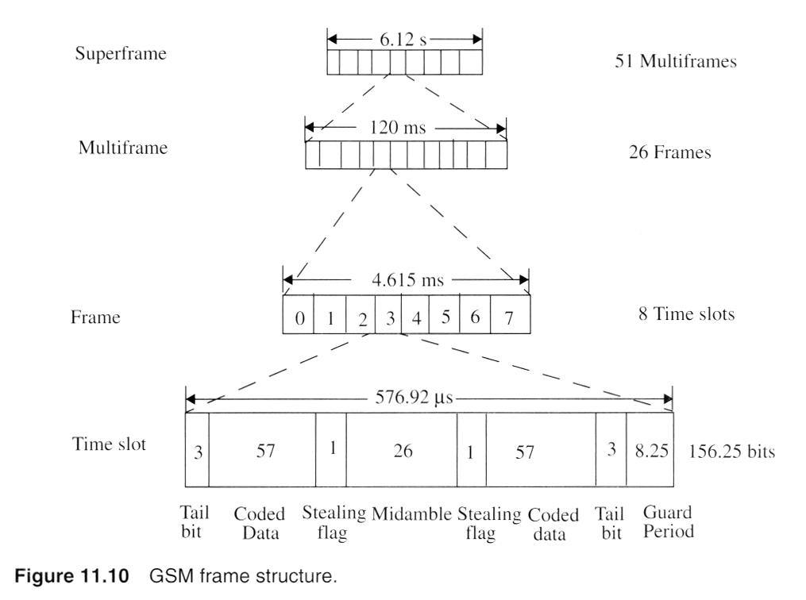
Notes:
Fig. 2.5

Slide 30
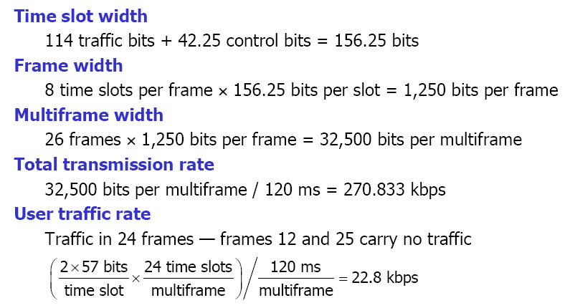
GSM Data Rate
Each traffic channel receives one slot per frame and 24 frames per 120-ms multiframe.

Slide 31
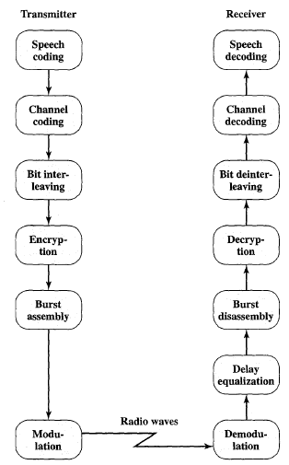
GSM Speech signal processing

Slide 32
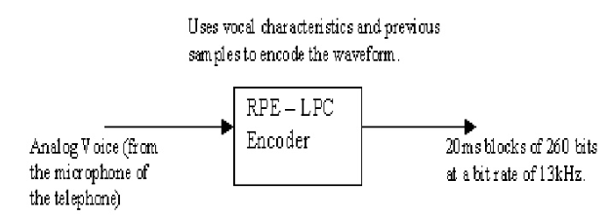
Speech Coding
The speech signal is compressed using an algorithm known as Regular Pulse Excited - Linear Predictive Coder (RPE-LPC).
This codec uses the information from previous samples in order to predict the current sample.
The speech signal is divided into blocks of 20 ms.
These blocks are then passed to the speech codec, which has a rate of 13 kbps, in order to obtain blocks of 260 bits.
Notes:
In order to send the voice information across a radio network, first thing to be done is to turn the voice into a digital signal.
36 bits/ 20 ms
9 bits/ 5 ms = 36 bits/20ms
47 bits/ 5 ms = 188 bits/20ms
Total = (36+36+188)/20ms = 260 bits/20ms

Slide 33
Channel Coding
GSM speech frame are divided in three different classes according to their function and importance.
Class Ia: 50 bits, most sensitive to bit errors
Class Ib: 132 bits, moderately sensitive to bit errors
Class II: 78 bits, least sensitive to bit errors
The different classes are coded differently:
The first 50 bits are protected by a 3-bit cyclic redundancy check (CRC) error detection code.
These 53 bits plus the 132 class 1b bits, plus a 4-bit tail sequence, are then protected by a convolutional (2, 1, 5) error correcting code, resulting in 189 X 2 = 378 bits.
The remaining 78 bits are unprotected and appended to the protected bits to produce a block of 456 bits,
Notes:
Channel coding adds redundancy bits to the original information in order to detect and correct, if possible, errors occurred during the transmission.
The channel coding is performed using two codes: a block code and a convolution code.
R=1/2 means – input bit 1 and output bit 2. K = 5 means # of shift register stages.

Slide 34
Interleaving
To further protect against the burst errors common to the radio interface, each sample is interleaved.
This method rearranges a group of bits in a particular way.
Each 456 bit block are then divided into eight blocks each containing 57 bits.
The first four blocks will be placed in the even bit positions of the first four bursts.
The last four blocks will be placed in the odd bit positions of the next four bursts.

Slide 35
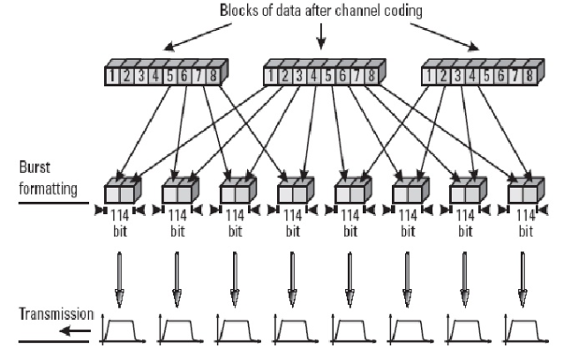
Interleaving

Slide 36
Encryption
It is used to protect signaling and data. This process is done using 3 algorithms :
A3 algorithm for authentication
A5 algorithm for encryption
A8 algorithm for key generation
Modulation
The modulation chosen for the GSM system is the Gaussian Minimum Shift Keying (GMSK).

Slide 37
2.5G – GPRS (General Packet Radio Service)
GPRS is a packet-switching-based data service for GSM.
Purpose is to provide increased data rates on existing 2G GSM network.
GPRS supports the world’s leading packet-based Internet communication protocols: Internet protocol (IP) and X.25.
One to eight time slots can be allocated to a user, or several active users can share a single time slot.
Theoretically, a GPRS connection can provide a data transmission speed of up to 171.2Kbps if all eight time slots are used.
Notes:
Global system for mobile communications (GSM) of 2G is mainly used for circuit-switched
communications. The general packet radio service (GPRS) is an extension of the GSM system, and
uses the same channels, the same modulation, and the same network backbone as the existing
GSM network. But the major difference is that GPRS is a packet-switching-based data service.

Slide 38
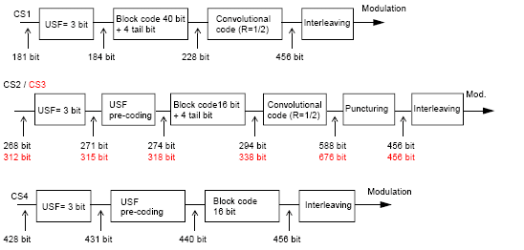
GPRS Coding Scheme
Notes:
GPRS offers a number of coding schemes with different levels of error detection and correction. These are given labels CS-1 to CS-4:
CS-1: It is used in scenarios when interference levels are high or signal levels are low.
CS-2: is a less reliable coding scheme and used for better channel.
CS-3: is an even less reliable coding scheme and used for more reliable channel than CS-2.
CS-4: is an unreliable coding scheme and used in when interference levels are low or signal levels are high.
Maximal data rate = 8*21.4 = 171.2Kbps per user

Slide 39
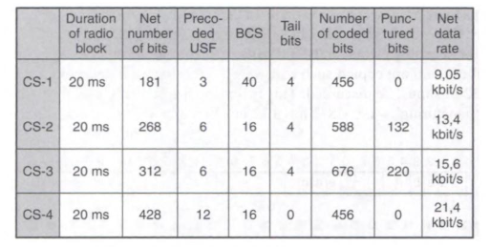
GPRS Coding Scheme
Notes:
Maximal data rate = 8*21.4 = 171.2Kbps per user

Slide 40
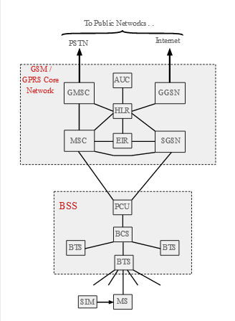
GPRS Architecture
PCU:
Packet Control Unit.
The PCU detects whether data is to be routed to the packet switched or circuit switched networks.
SGSN:
Serving GPRS Support Node.
Handles all packet switched data within the network.
It also stores the user profiles (e.g., IMSI, packet addresses used) for all the GPRS users
GGSN:
Gateway GPRS Support Node.
Responsible for the interworking between the GPRS network and external networks.
Notes:
GMSC = Gateway Mobile Switching Center: The Gateway Mobile Switching Centre (GMSC) is a special kind of MSC that is used to route calls outside the mobile network. Whenever a call for a mobile subscriber comes from outside the mobile network, or the subscriber wants to make a call to somebody outside the mobile network the call is routed through the GMSC.

Slide 41
2.75 – EDGE (Enhanced Data rates for GSM Evolution)
GSM EDGE cellular technology is an evolutionary upgrade to the existing GSM / GPRS networks, and can be implemented as a software upgrade to existing GSM / GPRS networks.
EDGE is capable of offering data rates of 384 kbps and theoretically up to 473.6 kbps.
Use of 8PSK modulation:
In order to achieve the higher data rates within GSM EDGE, the modulation format was changed from GMSK to 8PSK.
This provided a significant advantage in being able to convey 3 bits per symbol, thereby increasing the maximum data rate.
Several new coding schemes are introduced that offer net bit rates per time slot of up to 59.2 Kbps. If a subscriber has all the eight time slots of a carrier, the maximal theoretical data rate with EDGE is then
59.2 Kbps × 8 time slots = 473.6 Kbps.
Notes:
There are nine different Modulation and Coding Schemes (MCS) that can be used with EDGE. MCS 1 to MCS-9.

Slide 42
3rd Generation
The third-generation concept started in 1992, when ITU issued a blueprint called the Internet Mobile Communication 2000 (IMT-2000). The blueprint defines some criteria for third-generation technology as outlined below:
Voice quality comparable to that of the existing public telephone network.
Data rate of 144 kbps for access in a moving vehicle (car), 384 kbps for access as the user walks (pedestrians), and 2 Mbps for the stationary user (office or home).
Support for packet-switched and circuit-switched data services.
A band of 2 GHz.
Bandwidths of 2 MHz.
Same Network Standard for world wide.

Slide 43
Technologies of 3G
W-CDMA :Wideband Code Division Multiple Access.
CDMA 2000: Code Division Multiple Access.
TD-SCDMA: Time-division Synchronous CDMA
3.5G/3.5G+ is enhancement to 3G.
High-Speed Downlink Packet Access (HSDPA)
High-Speed Packet Access(HSPA)
Evolved High-Speed Packet Access (HSPA+)

Slide 44
3rd Generation—Internet System
3.5G – HSDPA (High-Speed Downlink Packet Access):
Provides a smooth evolutionary path for UMTS-based 3G networks allowing for higher data transfer speeds.
HSDPA is a packet-based data service in W-CDMA downlink with data transmission up to 8-10 Mbits over a 5MHz bandwidth in WCDMA downlink.
Implementations includes Adaptive Modulation and Coding (AMC), Multiple-Input Multiple-Output (MIMO), Hybrid Automatic Request (HARQ), fast cell search, and advanced receiver design.
3.75G – HSUPA (High-Speed Uplink Packet Access)
High Speed Uplink Packet Access (HSUPA) is a UMTS / WCDMA uplink evolution technology.
HSUPA will enhance advanced person-to-person data applications with higher and symmetric data rates, like mobile e-mail and real-time person-toperson gaming.
HSUPA will initially boost the UMTS / WCDMA uplink up to 1.4Mbps and in later releases up to 5.8Mbps.

Slide 45
4th Generation
The 4G mobile system is an all IP-based network system--Utilizing packet switching environment, LAN or WAN networks via VoIP.
4G technology integrate different current existing and future wireless network technologies.
Provides high quality audio/video streaming over end to end Internet Protocol.
The first two commercially available technologies considered as 4G were the WiMAX standard and the LTE standard
Data Rate: 4G LTE– peak download 100Mbps and peak upload 50 Mbps
WiMax—128 Mbps downlink and 56 Mbps uplink
4G based on OFDM (Orthogonal Frequency Division Multiplexing), which is the key enabler of 4G technology.

Slide 46
4th Generation
Applications :
Games
Games will be a major application segment in 4G.
Electronic Agents
There will be e-assistance, e-secretaries, e-advisors, e-administrators etc. This kind of control is what home automation applications anticipate.
Broadband Access in Remote Locations 4G networks will provide a wireless alternative for broadband access to residential and business customers. In addition, 4G will provide the first opportunity for broadband access in remote locations without an infrastructure to support cable or DSL access.

Slide 47
Comparison between 3G and 4G
Technology | 3G | 4G
Frequency band | 1.8 - 2.5GHz | 2 - 8GHz
Bandwidth | 5-20MHz | 15-200MHz
Data rate | Up to 2Mbps | 100Mbps moving - 1Gbps stationary
Core Network | Wide area concept: Circuit and Packet switching | Broadband, IP based Packet Switching
Technologies | W-CDMA, CDMA-2000 | OFDMA, MC-CDMA

Slide 48
5th Generation - Real Wireless World System
The next (5th) generation wireless network will address the evolution beyond mobile internet to massive IoT (Internet of Things) for the horizon 2020.
Characteristics
100 Times More Capacity Than 4G
Implements Massive MIMO with 96 to 128 antennas
Blazing Fast Internet—data rate upto10 Gb/s
Very Low Network Latency-- 1 millisecond latency
Custom Made Network Slices
Better Battery Life for Devices
Multiple Services Can Run in Parallel

